Slide 1
Dead body freezer price in Kerala
MG Dead Body Freezer

Slide 2
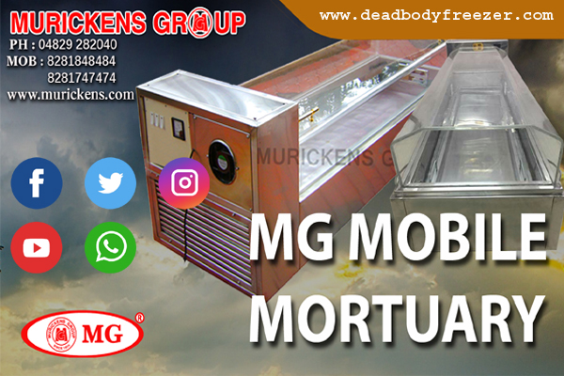
MG DEAD BODY FREEZER

Slide 3
1)Classic-1 dead body freezer- This special type of dead body freezer from the Murickans Group. It is an Italian Fiber glass top model gives a special look. The top opening cover of dead body freezer box is comprised of an acrylic class that is great for keeping up with inside high temperature over the long haul. MG classic one is light weight reduced and attractive model. Its body is made of 304 food grade steel. 2) Classic-2 dead body freezer- In MG Classic 2 Model Its top cover is embedded inside a steel outline. It is slightly shorter length and in height elevated one. The body materials utilized for this are 304 food grades steel.Structure of the body material - Full Steel and Copper. 3) MG M1 Dead body Freezer - It is semi squire shaped single Curved Acrylic glass with 12 mm thickness Fiber glass.The body material of this model is is 202 magnetic free stainless steel. Unit Compressor-250 W special.MG M1 is Standard Model with Fiber Glass Top. 4) MG M1 Special model - The top opening cover is acrylic class that inserted into a steel frame. This is a lightweight and compact model. For this reason it is mostly used for export. its top cover is made up of acrylic glass which lowers risk factors during long distance transportations.

Slide 4
5) MG M2 Dead body freezer - In MG M2 dead body freezer model structure of the body is stainless steel and copper, The body material is 202 nonmagnetic stainless steel.wattage of Compressor is 250 W Special type. 6) MG M3 model dead body freezer - This model is designed with compressor on bottom side and with elevated tray.The top cover is Fiber glass.This model is slightly shorter but taller. Its top cover is made of Acrylic class with a thickness of 12 mm. 7) MG M4 - MG M4 model dead body freezer manufactured by Murickens Group.Structure of the body material used is stainless steel and copper, The body material is 202 nonmagnetic stainless steel. 8) MG Gold - Extra Large(EL) with Special designed Single U Shape 6mm pure Glass with Golden Frame.Top Opening Door of this model is Special designed Single U Shape 6mm pure Glass with Golden Frame.Structure of the Body material is Full Steel and Copper. 9) MG Gold 1 - This model is manufactured by Murickens Group.Top Cover of this model is made up of Extra Large(EL) Fiber Glass Top With Golden Color Handle.The Bottom body of these three models (MG Gold, MG Gold-1, MG Gold-3)are same.ie,Length:203.2 cm (80 inches). Height:88.9 cm (35 inches). Width:71.12 cm (28 inches). 10) MG Gold 2 - In MG Gold-2 top opening Cover is U Shape 6mm Glass fitted on specially designed Stainless steel frame with Silver color.Total Weight of this model is 127 Kg.Dimension of this Model is 80 " x 35 " x 28 ": ( 203.2 cm x 88.9 cm x 71.12 cm).

Slide 5
Video Links
https://youtu.be/jq9__Pju3B0
https://youtu.be/nzber_10g_0
https://youtu.be/eC8k21n4kq4

